Slide 1


Slide 2

EDU Revolution: Be the Change
New Year
New Beginning
New Excitement

Slide 3
Adder
Subtractor
Combinational Circuits
Comparator
Multiplexer
De-Multiplexer
Encoder
Decoder

Slide 4
Outline
Combination Circuits
Adder

Slide 5
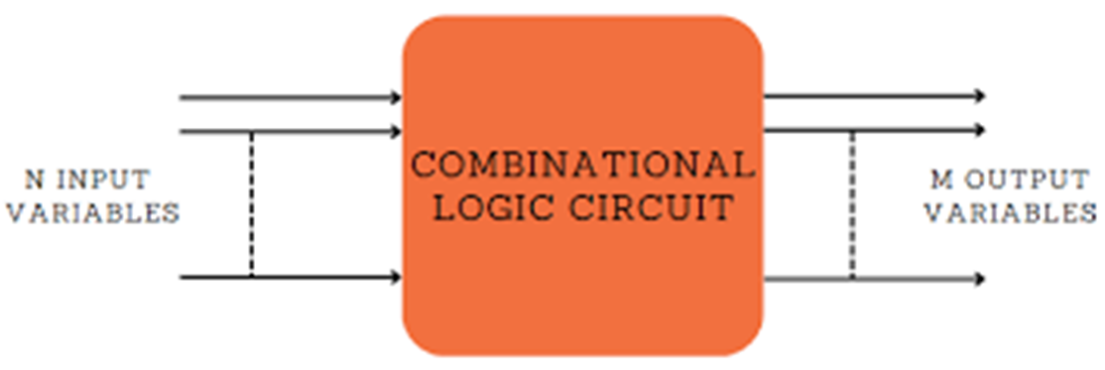
Combinational Circuits
External
source
External
destination
For n input variables, there are 2^{n} possible combinations of binary input.
For m output variables, only one output combination is possible with each possible combination input value.

Slide 6
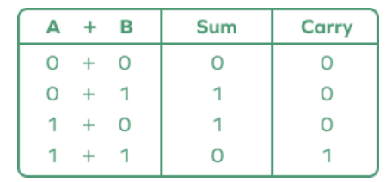
Binary Addition

Slide 7
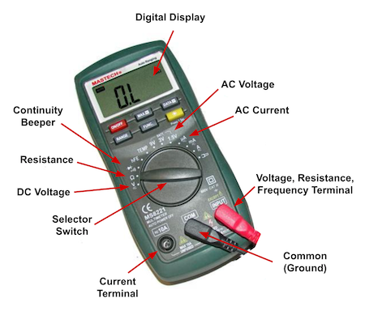


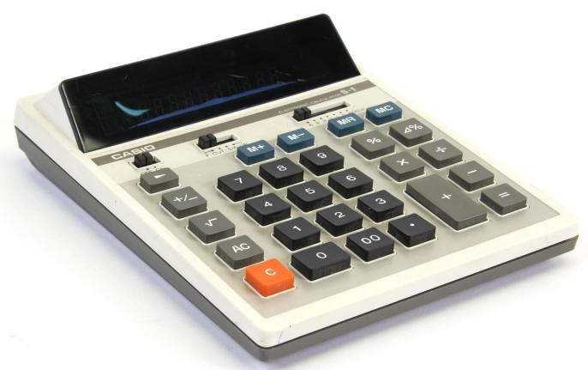

Adders
Adder is a digital circuit that performs addition of numbers.
Adder

Slide 8
Types of Adder
Half Adder
Types of Adder
Full Adder

Slide 9
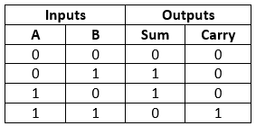
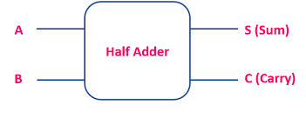
Half Adder
Half adder is a combinational logic circuit with two inputs and two outputs.
Block diagram and Truth Table

Slide 10
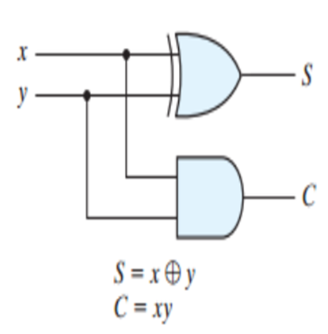
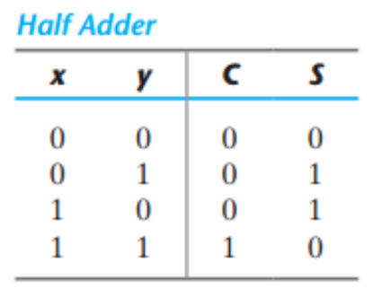
Half Adder

Slide 11
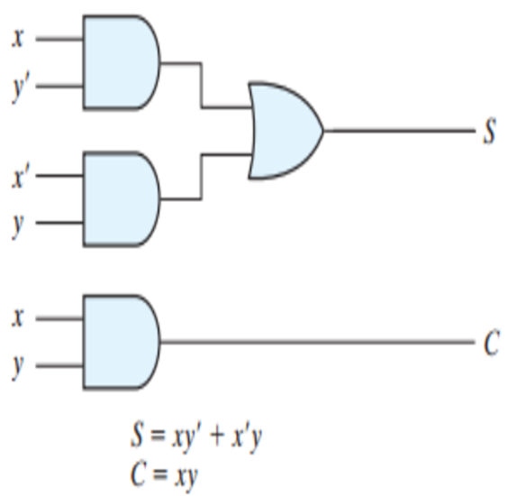
Half Adder
Diagram and Truth Table

Slide 12
Quick Quiz: Poll
If A and B are the inputs of a half adder, the sum is given by
a) A AND B
b) A OR B
c) A XOR B
d) A EX-NOR B

Slide 13
Quick Quiz: Poll
Total number of inputs in a half adder is __________
a) 2
b) 3
c) 4
d) 1

Slide 14
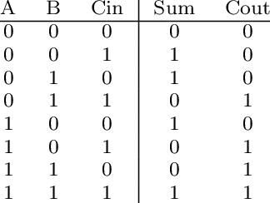
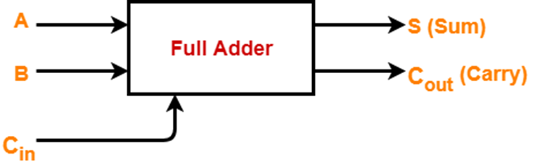
Full Adder
A combinational logic circuit with 3 inputs and 2 outputs.
The Full adder circuit adds 3 bits including carry.

Slide 15
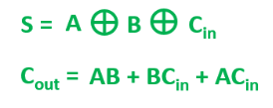
Full Adder

Slide 16
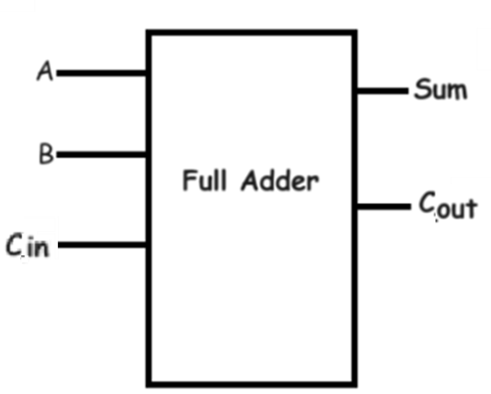
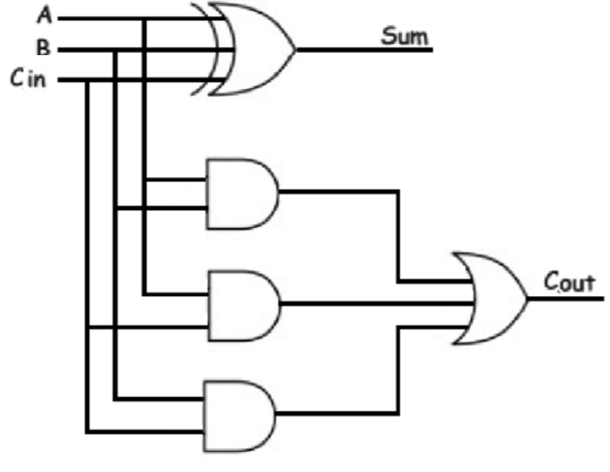
Full Adder

Slide 17
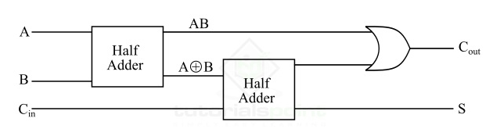
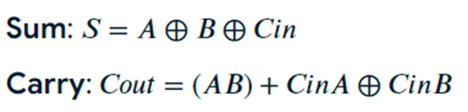
1-bit Full-adder implemented with two half adders and one OR gate
Full Adder

Slide 18
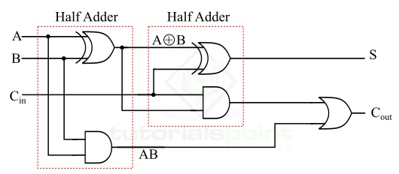
Full Adder

Slide 19
Quick Quiz: Poll
If A, B and C are the inputs of a full adder then the carry is given by __________
a) A AND B OR (A XOR B) AND C
b) A OR B OR (A AND B) C
c) (A AND B) OR (A AND B)C
d) A XOR B XOR (A XOR B) AND C

Slide 20



